Slide 1
BIOL 792 (1028)
Data Science for Biology I
FH 106
Tuesday and Thursday 6:00 – 7:15
Dr. Thomas Parchman

Slide 2
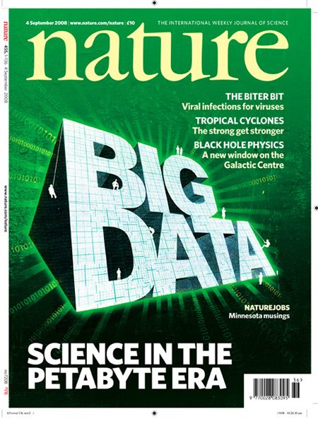
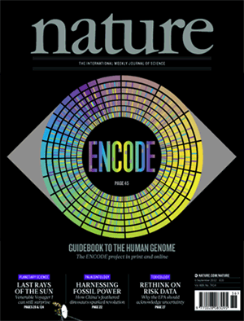

Slide 3
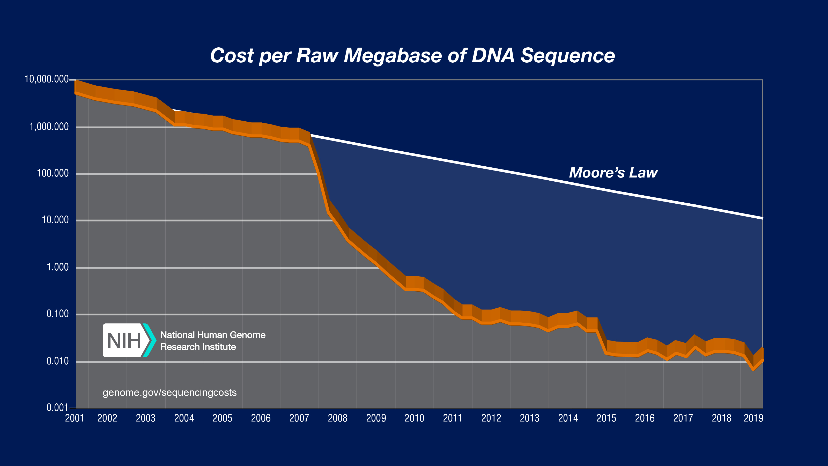
Big Data Science: Genomics
Next generation
sequencers debut
Cost of DNA sequencing is now 1,000,000 times cheaper and faster than 10 years ago

Slide 4
Human Genome Project (1990- 2003)
First draft human genome released in 2003.
- 3,000,000,000 dollars, 13 years, 100s of people
De novo whole genome sequencing today
- About $25,000 for a genome of a non-model organism
- Nature 2020: One paper with 350 bird genomes

Slide 5
Big data is relevant for all of science
Scientists are spending less time generating data
and
more time handling and analyzing data

Slide 6
Example of change for population genetics
Then (15 years ago)
Now
400 individuals, 15 microsatellite loci
6000 PCR reactions after troubleshooting, and before reruns
PCR products run separately for each individual and each locus
- 6-12 months of lab work
- 15 loci, $16,000.00
400 individuals, pooled Illumina sequencing
- 400 PCR reactions
- 3 days of lab work
- 900,000,000 DNA sequences, maybe 80,000 SNPs, $6,000.00

Slide 7
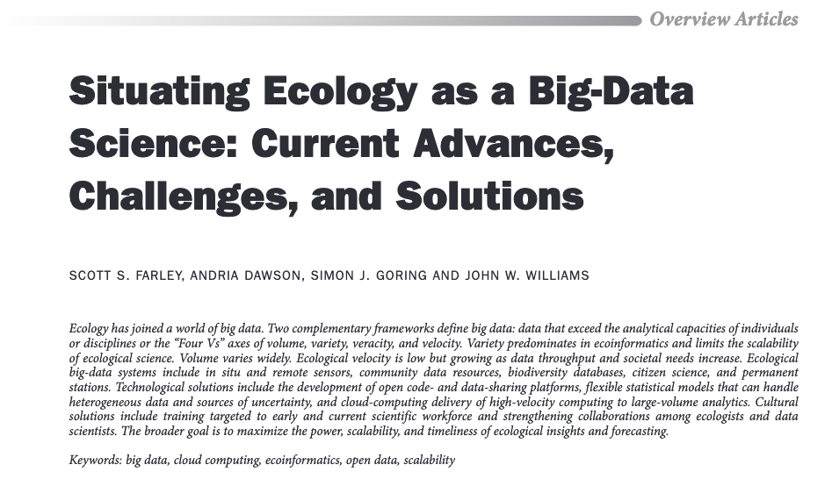
Big data is relevant for all of biology
Farley, et al. 2018. BioScience, 68:563-576

Slide 8
Why learn Unix?
Accessing, manipulating, and moving large data around (around your computer, or among computers).
Working on remote computers and high-performance computing clusters.
>250,000 built in tools and commands, can be used for efficient scripting of workflow.
First step at becoming enabled for data science and more generally for data handling and analysis.

Slide 9
Why learn Python?
- Among the most common languages used in biology and other fields of science. A lot of documentation, guidance, examples, and opinion on the internet.
- Excellent capabilities for manipulating text, suiting it well to bioinformatics and data science, and pretty much anything else.
- It uses consistent syntax, which makes learning specific code relatively easy.
- It has many built in libraries to facilitate common tasks.
- If you learn this as your first language, it will make learning others much easier.

Slide 10
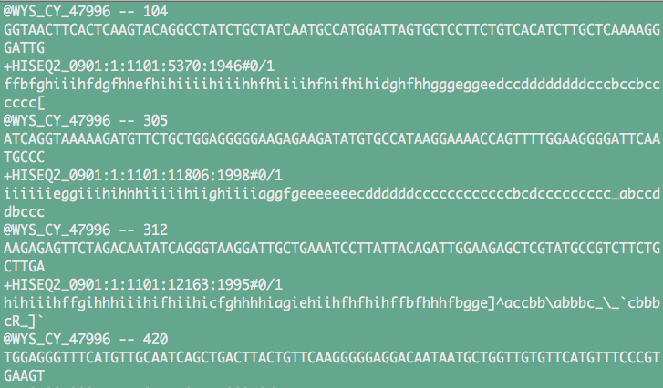
Information from the first four DNA sequences from a data file that has 800,000,000 DNA sequences generated with an Illumina HiSeq instrument

Slide 11


Slide 12
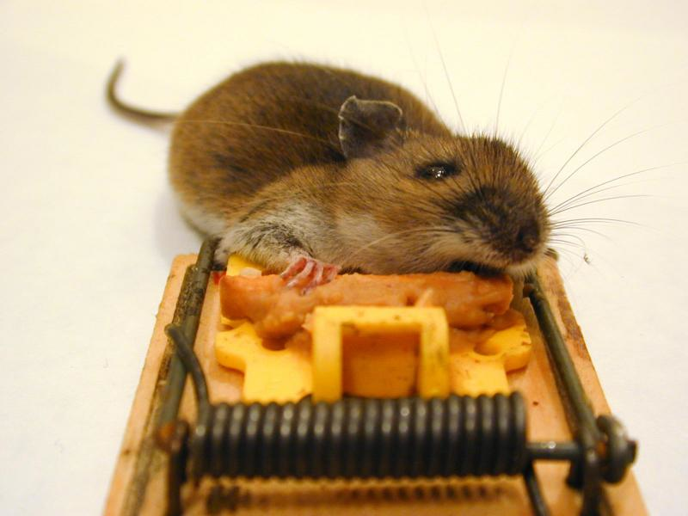
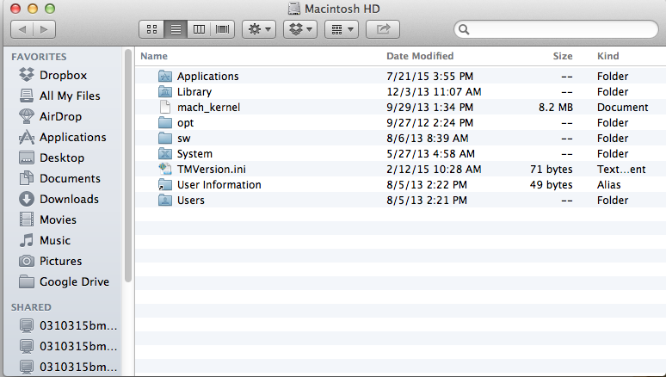

Navigating Directories

Slide 13

High performance computing clusters are accessed and run with Unix (or Linux)
Unix tools: ssh, sftp, wget, ftp, job schedulers (torque, sungrid engine)

Slide 14
At the end of this course, you should:
Be comfortable with using Unix/Linux for basic and slightly more advanced needs
Be able to write basic programs in Python (and feel encouraged to learn more on your own).
Be able to use Unix, Python, and shell scripting to manipulate, organize, and analyze large data sets.
Feel enabled and equipped to work with big data, and motivated and capable of learning more on your own.
Be prepared for Julie Allen’s Data Science for Biology II, spring semester.

Slide 15
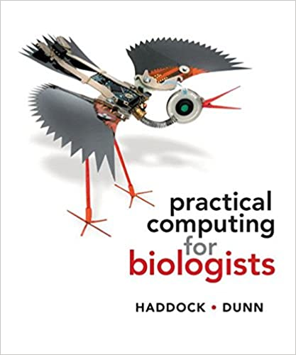
Course Resources
Computer with Unix and Python installed, preferably mac or machine running linux.
Supplementary data and problem sets for projects will be provided throughout the semester on the course github page.
Text book (to left), and supplemental unix material from ”Unix and Perl to the Rescue”, Bradnam and Korf.

Slide 16
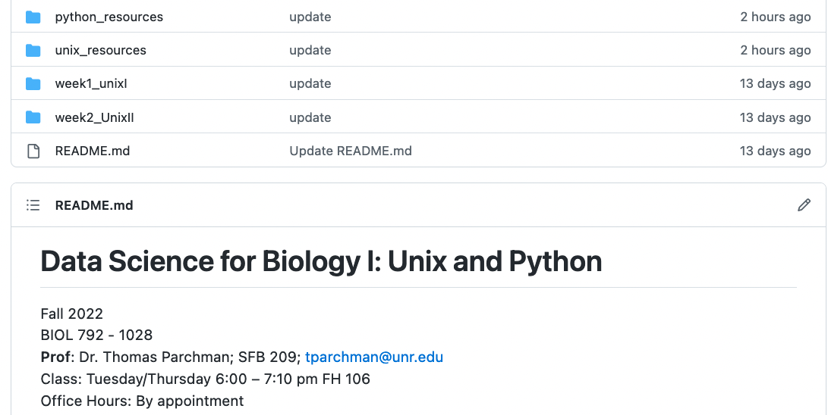
Course site: https://github.com/tparchman/F22_BIOL792_coursepage
Weekly primers and task/problem assignments
Supplemental material for learning Unix and Python
Repositories for sharing code with each other

Slide 17
Other suggested resources:
- Primer for a supplemental book that is very useful for Unix (and Perl if you so desire)
http://korflab.ucdavis.edu/Unix_and_Perl/current.html
- Python documentation:
https://docs.python.org/3/
- Online Python for Biologists (by Martin):
https://pythonforbiologists.com/introduction
- Learn Python Interactive (has built in interpretter)
https://www.learnpython.org/
- Python guru (excellent, has built in interpretter)
https://thepythonguru.com/
*I suggest bookmarking a few of the above and revisiting regularly

Slide 18
Course Outline
Weeks 1 through 3/4: Learning how to live in the Unix environment
-directory navigation, moving, copying, syncing
-basic Unix tools for efficient data handling
Weeks 3/4 through 10/11: Basic programming in Python
-input/output, basic syntax, debugging
-data structures (scalars, arrays, dictionaries)
-regular expressions, mathematical operation, indexing, data wrangling
Weeks 11 through 15: Incorporating what you have learned in Unix and Python to manipulate and analyze some big data sets
- Some of these problems may involve data from my lab, some may involve data and problems supplied by your classmates, and some will be for your independent projects.

Slide 19
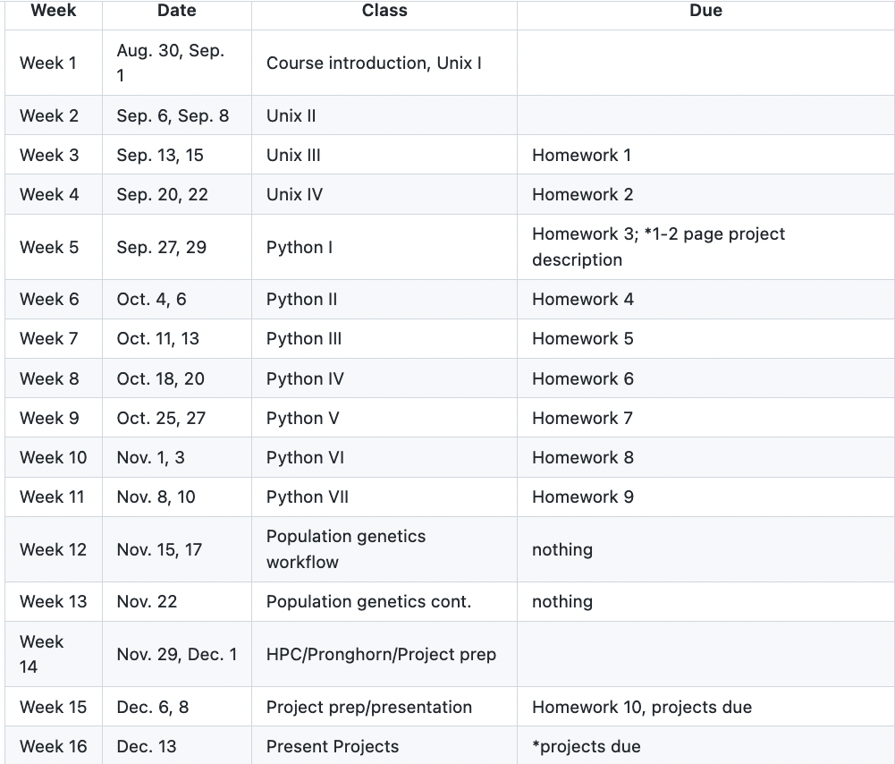
Note: timeline may shift depending on the pace of the class

Slide 20
Grading for the course:
Participation (30%)
Weekly Assignments (50%)
For weekly assignments, you can (and I highly recommend) work in teams of up to THREE. Starting materials for projects will be supplied in directories that contain a type of data file, an explanation of the problem, and advice on how to use Unix, Python, or R to parse data, conduct some analyses, or just do some stuff.
For these projects, and especially for real world computational projects, keeping track of EVERYTHING you do will be essential.
For Unix projects, you will turn in annotated notes of the commands you executed and what they accomplished.
For Python projects, you will turn in your scripts, with comment lines used to explain your rationale.

Slide 21
Grading for the course (continued):
3. Independent (or group) project (20%)
You may work independently, or in a group of up to THREE.
Identify a task or problem in your research (or the research of the group you work within) that either requires, or can be made much more efficient, using Perl or Unix scripting. The idea here is to force you to identify a real problem, and to build something useful to solve it.
Deliverables:
Before week 5: Turn in a 1-2 page description of the problem, the data, and how you plan to implement something in Unix, Python, or both, to get something done.
By week 14: Turn in your Unix and/or Python code and a 1-3 page description of how your creation works.
Weeks 14/5. 10-15 minute presentation to the class on your problem and how you solved it.

Slide 22
Before Thursday:
Read Haddock and Dunn (pgs 1-15 only), first half of Chapter 4.
Make sure you have access to a computer with Unix/Linux
If you have a mac, you are set
If you can run linux (ubuntu for example) on your computer, you are set.
If you have a PC, read up on options in week1 primer
3. Pick and install a text editor. (You will not want to use notepad or a word processing software). I strongly suggest Bbedit, TextWrangler, or Visual Studio Code. Get yourself acquainted with the program. If you have experience working with other syntax recognizing text editors, feel free to use your favorite flavor.

Slide 23
A note on text editors:
- Programs are typically just text files; they contain text written commands for operations, functions, input/output, etc.
- Microsoft Office Documents and Excel documents are NOT text files; We will NOT be using either.
- Syntax recognition is built into editors used for programming (VIM, Emacs, TextWrangler, BBedit)
**This will help with understanding the code you are writing, and more importantly in debugging.

Slide 24
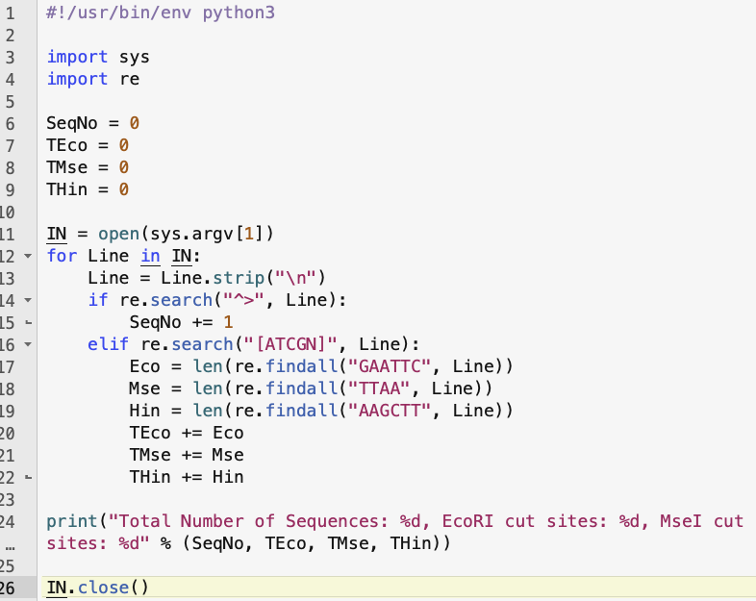
BBEdit – Recommended for this module
Python
script

Slide 25
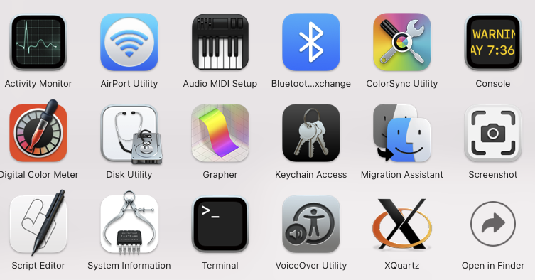
Introduction to the Unix terminal
Applications -> Utilities
Put a link somewhere to make opening this quick, as you will use it for everything in this course (add it to dock on a mac)

Slide 26
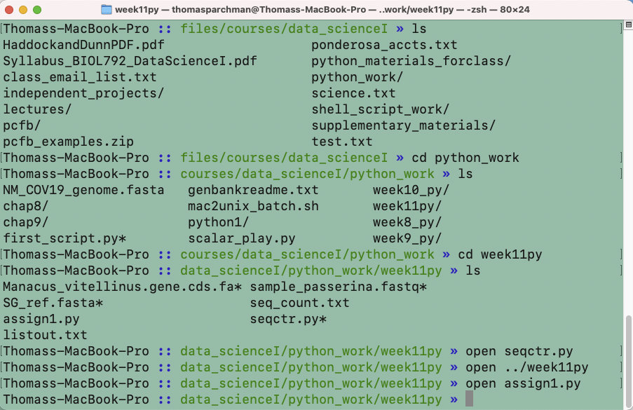
- make the text larger/smaller (hold down ‘command’ and either ‘+’ or ‘–’)
- have multiple terminal windows on screen (see the ‘Terminal’ menu)
- have multiple tabs open within each window (again see the ‘Terminal’ menu)
- Command ‘N’ to open additional windows

Slide 27
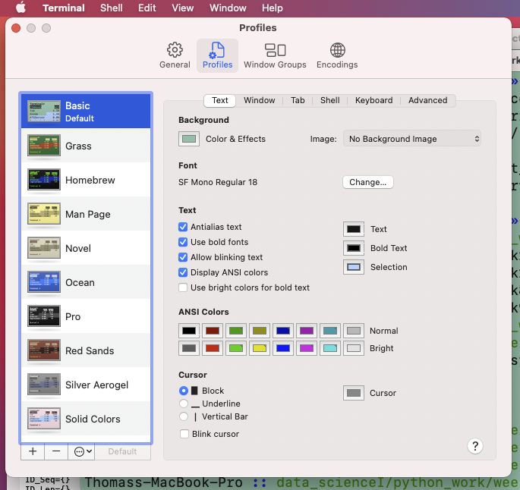
Customize Terminal
Background color,
text size, font, color, etc.

